Slide 1
Artificial Intelligence
Planning

Slide 2
Planning
Introduction
Classical Planning
  Ground Atomic Fluent (Predicates)
  Action Schema
    Preconditions
    Effects
  Examples
  Hierarchical Planning
Planning in nondeterministic Environments
  Sensorless Planning (No observation Environments)
  Contingency Planning (Partially Observable Environments)
  Online Planning (Unknown Environments)

Slide 3
Planning
Planning is the process of generating a sequence of actions to achieve a specific goal from an initial state.
It involves reasoning about the effects of actions in a given environment and the preconditions required.
Search is general: it just finds a path from a start state to a goal state, without worrying much about what actions mean or whether they can actually be performed.
Planning is specific: It considers action preconditions, effects, and constraints, generating a sequence of actions that can actually achieve the goal.
Search:
  “Get from home to office” → finds a route on the map.
Planning:
  “Wake up → brush teeth → have breakfast → drive car → park at office → walk to desk” → ensures each action can actually be performed in sequence to reach the goal.

Slide 4
Classical Planning
Classical planning is defined as the task of finding a sequence of actions to accomplish a goal in a discrete, deterministic, static, fully observable environment.
Planning researchers have invested in a factored representation using a family of languages called PDDL, the Planning Domain Definition Language.
PDDL allows planners to define actions with preconditions and effects, representing states compactly without enumerating every possible scenario.
Basic PDDL can handle classical planning domains, and it is based on Lisp language.

Slide 5
Ground Atomic Fluent
In PDDL, a state is represented as a conjunction of “ground atomic fluents”.
The
“ground” means no variables,
“fluent” means an aspect of the world, and
“ground atomic” means there is a single predicate, and if there are any arguments, they must be constants.
For example,
At(Truck1,Melbourne) → Truck1 is at Melbourne
At(Truck2,Sydney) → Truck2 is at Sydney
At (Cargo1, Airport1) → Cargo1 is at Airport1
At (Cargo2, Airport2) → Cargo2 is at Airport2
In (Cargo3, Plane1) → Cargo3 is loaded in Plane1

Slide 6
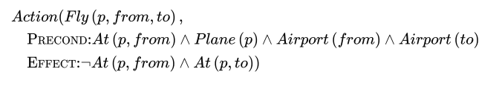
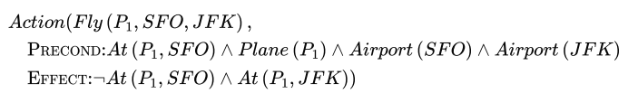
Action Schema
An action schema represents a family of ground actions. For example, here is an action schema for flying a plane from one location to another:
The schema consists of the action name, a list of all the variables used in the schema, a precondition and an effect.
The precondition and the effect are each conjunctions of literals (positive or negated atomic sentences).
We can choose constants to instantiate the variables, yielding a ground (variable-free) action:

Slide 7
Example domain: The spare tire problem
Consider the problem of changing a flat tire.
The goal is to have a good spare tire properly mounted onto the car’s axle.
The initial state has a flat tire on the axle and a good spare tire in the trunk.
To keep it simple, our version of the problem is an abstract one, with no sticky lug nuts or other complications.
There are just four actions:
  removing the spare from the trunk,
  removing the flat tire from the axle,
  putting the spare on the axle,
  and leaving the car unattended overnight.
We assume that the car is parked in a particularly bad neighborhood, so that the effect of leaving it overnight is that the tires disappear.

Slide 8
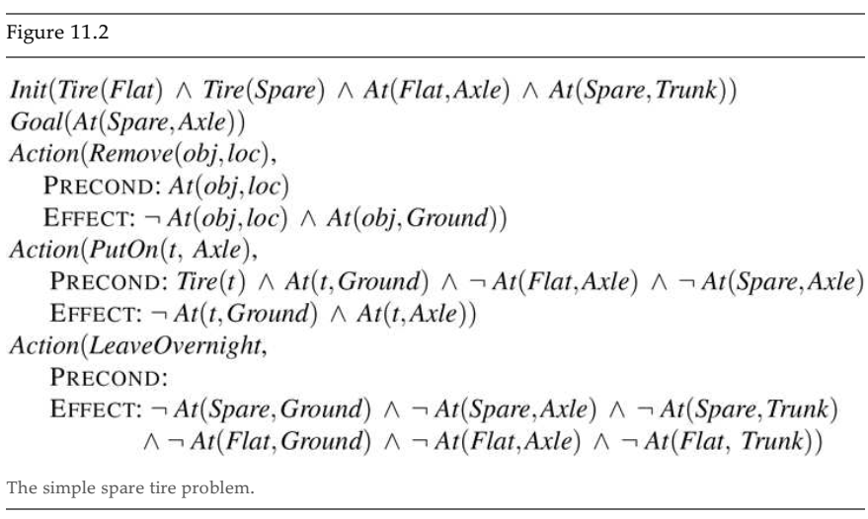
Example domain: The spare tire problem
The following plan is a solution to the problem:

Slide 9
Example
Figure 11.1 shows an air cargo transport problem involving loading and unloading cargo and flying it from place to place.
The problem can be defined with three actions: Load, Unload, and Fly.
The actions affect two predicates: In(c,p) means that cargo c is inside plane p and At(x,a) means that object (either plane or cargo) is at airport. .
When a plane flies from one airport to another, all the cargo inside the plane goes with it.
In first-order logic it would be easy to quantify over all objects that are inside the plane. But PDDL does not have a universal quantifier, so we need a different solution.
The approach we use is to say that a piece of cargo ceases to be At anywhere when it is In a plane; the cargo only becomes At the new airport when it is unloaded.
So At really means “available for use at a given location.”

Slide 10
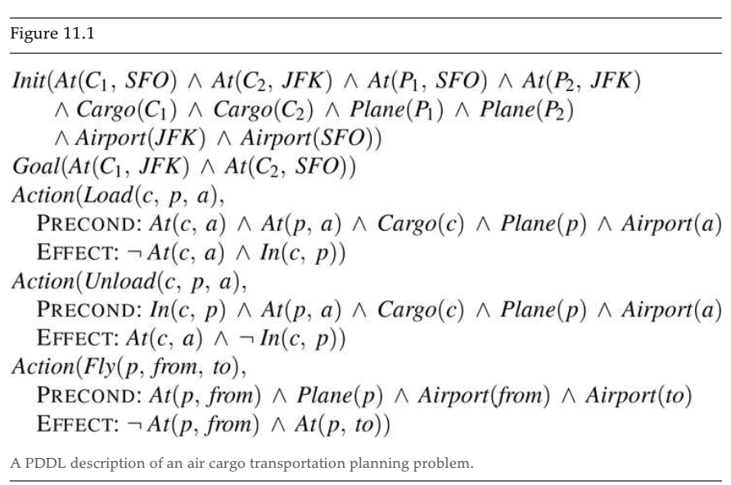

Example domain: Air cargo transport
The following plan is a solution to the problem:

Slide 11
Classical Search Algorithms
In classical planning, several well-known planning algorithms are used to generate a complete plan under deterministic and fully observable assumptions.
These algorithms mainly differ in how they search for a plan.
Forward (Progression) Search
  Starts from the initial state
  Applies actions to reach the goal state
Backward (Regression) Search.
  Starts from the goal state
  Works backward to the initial state
  Searches for actions that could achieve the goal
  Backward search (regression planning) works by starting from the goal, selecting actions that can achieve it, replacing the goal with their preconditions, and continuing until the regressed goal is satisfied by the initial state.

Slide 12
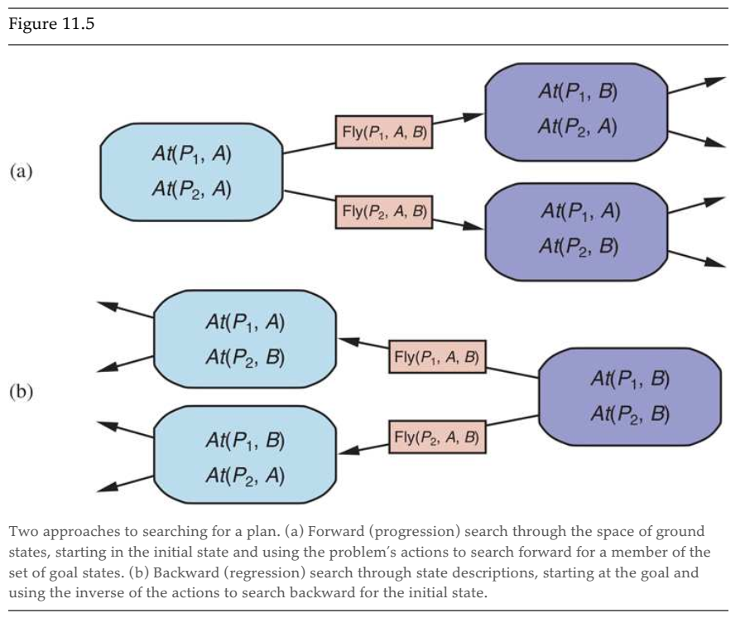

Slide 13
Example domain: The spare tire problem
The following plan is a solution to the problem:

Slide 14
Forward (Progression) Search
Step 1: Start from the initial state
  At(Flat, Axle)
  At(Spare, Trunk)
Step 2: Apply applicable actions
Action: Remove(Flat, Axle)
Precondition satisfied
  At(Flat, Ground)
  At(Spare, Trunk)
Step 3: Continue search
Action: Remove(Spare, Trunk)
Precondition satisfied
  At(Flat, Ground)
  At(Spare, Ground)
Step 4: Apply PutOn(Spare, Axle)
Preconditions satisfied:
  Tire(Spare)
  At(Spare, Ground)
  Axle empty
At(Spare, Axle)
At(Flat, Ground)
Step 5: Goal test
  Goal achieved
Solution Path:
  1. Remove(Flat, Axle)
  2. Remove(Spare, Trunk)
  3. PutOn(Spare, Axle)

Slide 15
Backward (Regression) Search
Step 1: Start from the goal
  G0 = { At(Spare, Axle) }
Which action can achieve At(Spare, Axle)?
Applicable action
  PutOn(Spare, Axle)(because its effect includes At(t, Axle))
Step 2: Regress the goal through PutOn
Action: PutOn(Spare, Axle)
Preconditions:
  Tire(Spare)
  At(Spare, Ground)
  ¬At(Flat, Axle)
  ¬At(Spare, Axle)
Regression rule
  Remove achieved goal: At(Spare, Axle)
  Add preconditions
  G1 = {
  Tire(Spare),
  At(Spare, Ground),
  ¬At(Flat, Axle)
  }
Step 3: Regress G1 further
  Which action can achieve At(Spare, Ground)?
Applicable action
  Remove(Spare, Trunk)
  At(Spare, Trunk)
  G2 = {
  Tire(Spare),
  At(Spare, Trunk),
  ¬At(Flat, Axle)
  }

Slide 16
Backward (Regression) Search
Step 4: Handle ¬At(Flat, Axle)
Which action removes At(Flat, Axle)?
Applicable action
  Remove(Flat, Axle)
  Regress through Remove(Flat, Axle)
Preconditions
  At(Flat, Axle)
  New regressed goal
  G3 = {
  Tire(Spare),
  At(Spare, Trunk),
  At(Flat, Axle)
  }
Step 5: Check against initial state
  Tire(Spare)
  At(Spare, Trunk)
  At(Flat, Axle)
All goals satisfied
Final Solution
  Regression finds actions backward, so reverse them:
  1. Remove(Flat, Axle)
  2. Remove(Spare, Trunk)
  3. PutOn(Spare, Axle)

Slide 17
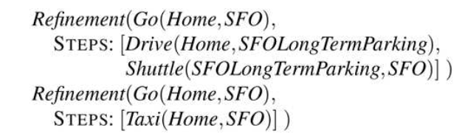
Hierarchical Planning
Hierarchical planning is a planning approach in Artificial Intelligence in which a complex problem is solved by breaking it down into smaller, more manageable subproblems arranged in multiple levels of abstraction.
We distinguish actions in:
  Primitive actions: Directly executable by the agent.
  High Level Actions (HLA): Each HLA has one or more possible refinements in terms of a sequence of primitive or high level actions.
For example, the action “Go to San Francisco airport,” represented formally as Go(Home,SFO), might have two possible refinements.

Slide 18
Planning and acting in nondeterministic domains
Consider partially observable, nondeterministic, and unknown environments.
Sensorless planning (also known as conformant planning) for environments with no observations;
Contingent planning for partially observable and nondeterministic environments;
Online planning and re-planning for unknown environments.
The belief state in all these cases is uncertain. For this reason we need to change the representation of states.

Slide 19
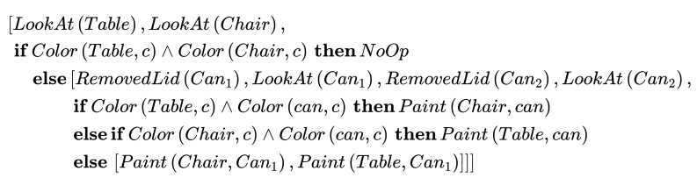
Contingency Planning
Contingency planning is a planning approach in AI where the agent plans in advance for multiple possible outcomes, especially when actions or observations are uncertain.
Contingency planning plans ahead for “if–then” situations
Contingent planning is the generation of plans with conditional branching based on percepts.
It is appropriate for environments with partial observability, nondeterminism, or both.
The action is selected on the basis of perceptions.

Slide 20
Online Planning
Online planning is a decision-making approach in AI and intelligent agents where the agent plans while it is acting, rather than computing a complete plan in advance.
In contingent planning you have to consider all the contingencies that may arise. An alternative, or addition, to contingent planning is replanning during execution.
Replanning presupposes some form of execution monitoring to determine the need for a new plan.
The agent observes the current state of the environment
  It computes the next best action (or a short sequence of actions)
  Executes the action
  Observes feedback from the environment
  Updates its plan and repeats the process
  The plan is continuously refined as new information becomes available.

Slide 21
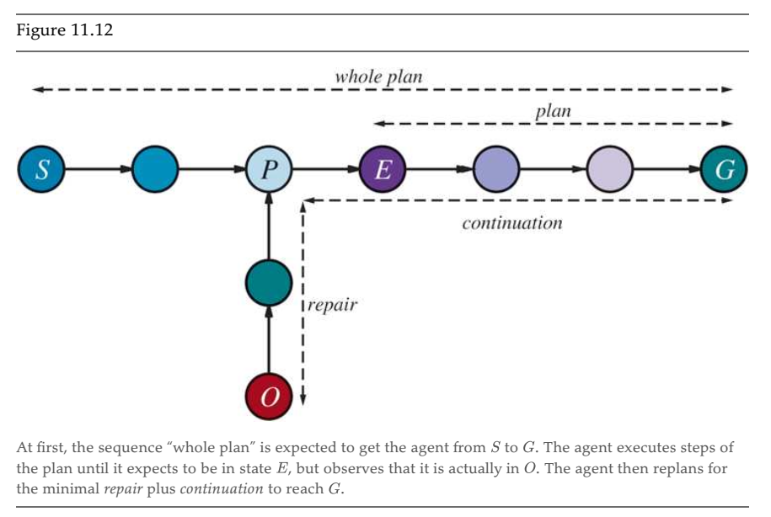

Slide 22
Figure 11.1 Elaboration
Whole plan (offline idea)
  At the beginning, the agent creates a whole plan from S → G.
  This assumes everything will go exactly as expected.
Plan execution
  The agent starts executing actions from S.
  It follows the plan and reaches state P, then continues.
Expectation vs reality
  According to the plan, after some actions the agent expects to be in state E.
  However, when it checks the environment, it finds itself in state O instead. This mismatch happens because the environment is:
    uncertain
    nondeterministic
    partially observable

Slide 23
Figure 11.1 Elaboration
Replanning (repair)
  Instead of throwing away the entire plan, the agent computes a minimal repair from O → P (or a nearby planned state).
  This is the short vertical path labeled “repair” which is key to online planning: fix only what went wrong, not everything.
Continuation
  After the repair, the agent rejoins the original plan.
  It then follows the remaining actions from E → G.
  This is shown by the dashed line labeled “continuation”.

Slide 24
References
Chapter 11, Artificial Intelligence, A Modern Approach, Forth Edition, Stuart Russell and Peter Norvig

